Slide 1
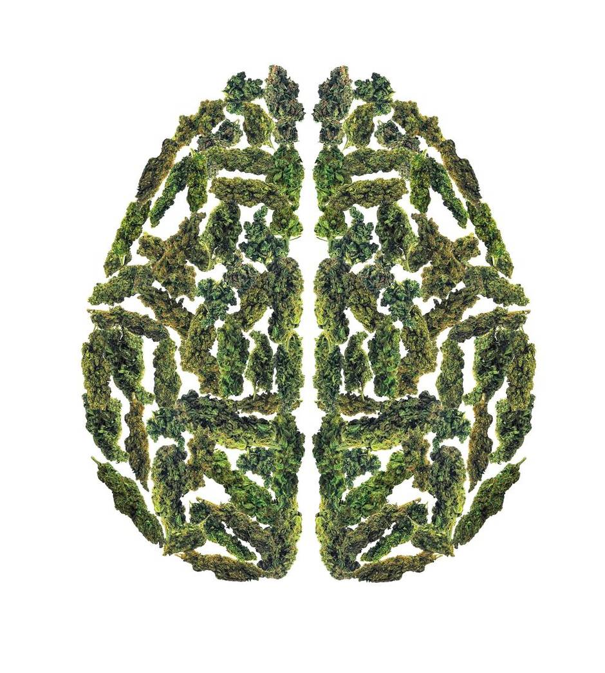
Cannabis and The Teenage Brain
Safdar Medina, MD
Assistant Professor of Pediatrics, University of Massachusetts
Pediatric Director, Tri River Health Center, Uxbridge
School Physician, Northborough/Southborough School District

Slide 2
The Marijuana Plant

Slide 3
Why do Teens use drugs?
Sensation/Thrill Seeking
Poor Impulse Control
Self-Medication for Anxiety/Depression-Most have dual diagnoses
Media/Popular Messages have a powerful influence

Slide 4
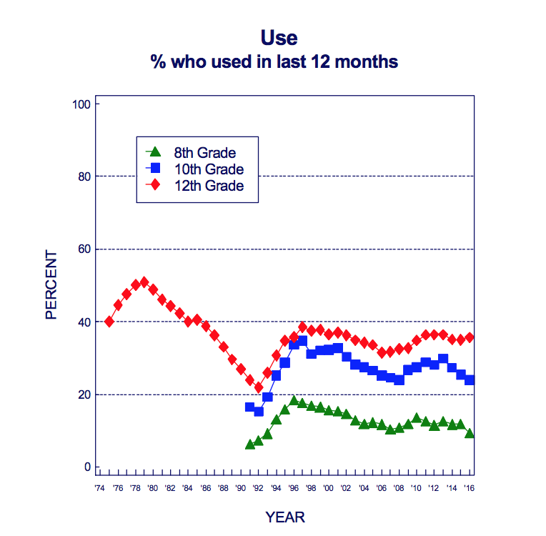
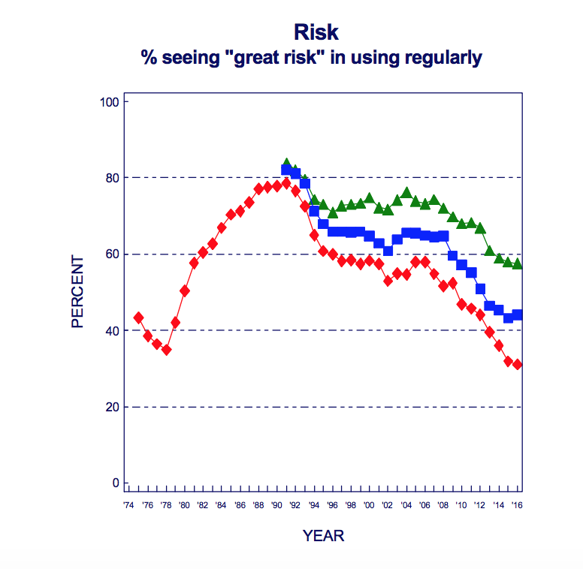
Teens Perceive Marijuana as Being Safe
Monitoring The Future, University of Michigan, 2017

Slide 5
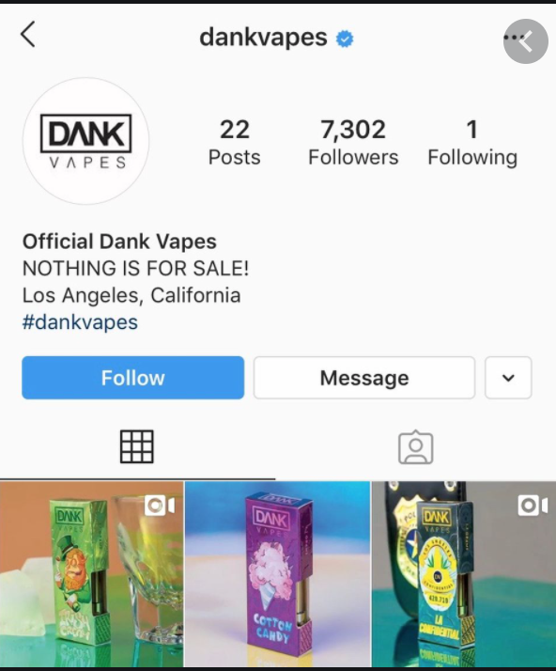
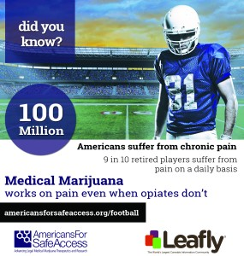
Big Cannabis--The New Big Tobacco
100% of teens have been exposed to marijuana advertising according to a youth survey conducted in the Cincinnati suburbs.
Social Media messages decrease teens’ perception of harm of marijuana
Teens who see ads for Medical Marijuana are more likely to use the drug:
California: 5,000 middle school students, followed from 2010-2017. The number of teens who had seen an ad increased from 25% to 70%; Rates of Use Increased; Higher Rate of Negative Consequences
Drug And Alcohol Dependence, 2018

Slide 6
Effect of Legalization
Survey of 3 million 7th, 9th, and 11th graders in California
Between 2017-2018, and 2018-2019
23% increase in past 30 day marijuana use
18% increase lifetime use
Journal of Studies on Alcohol and Drugs, 2021

Slide 8
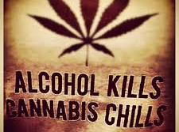
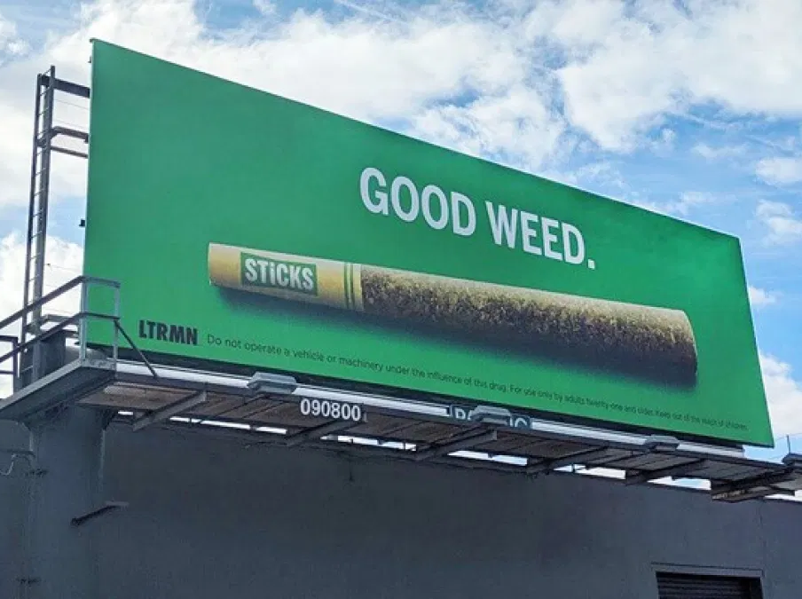
“Not As Bad”
But it is bad for you.
What’s better: smoking weed or not smoking weed?
Would you rather jump off of a 4 story building or a 8 story building?

Slide 10
“Natural”
Natural does not mean safe!
Some examples of other natural dangerous plants:
Poison Ivy, Heroin, Poisonous Berries
Remember: The marijuana of the 60s was 1-3% THC; marijuana of today: 12%; The plant did not do this itself--genetically modified

Slide 11
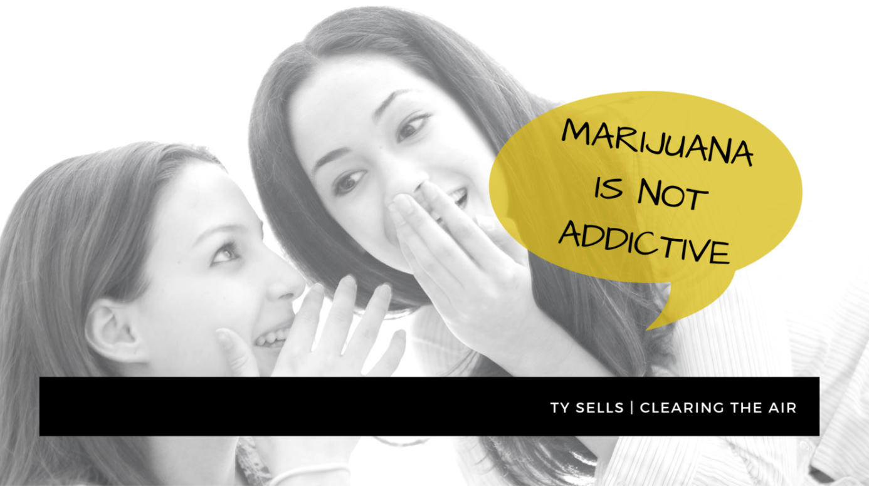

Slide 12
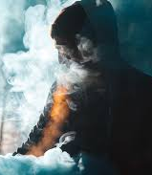
It is Addictive
1 in every 6 adolescents who use marijuana will develop an addiction
(National Institute of Drug Abuse)

Slide 14
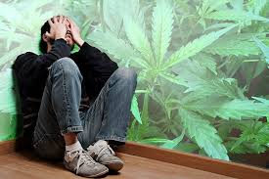
While you can’t “OD”...
Psychosis can be caused by heavy marijuana ingestion (dabbing, vaping, edibles)
Psychotic Events can lead to death

Slide 16
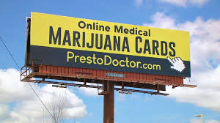
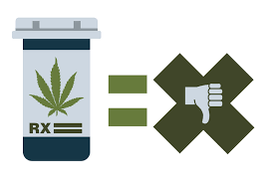
Marijuana Is Not a Medicine
Only FDA approved use for CBD is for Dravet Syndrome (Seizure Disorder)
Need dosing regimen, monitoring side effects
Does not treat anxiety or depression; no proof for chronic pain.
States that legalize medical marijuana, end up legalizing recreational sales
Nicotine was promoted as “healthy” by Big Tobacco

Slide 18
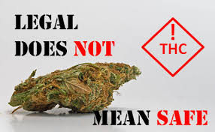
Marijuana is Legal
There are legal drugs that are not safe:
Alcohol is legal. Tobacco is legal.

Slide 19
Massachusetts Youth Risk Behavior Survey, 2019
Tried marijuana before age 13: 4.0%
Ever tried marijuana: 41.9%
9th grade: 24.5%
10th grade: 34.3%
11th grade: 46.4%
12th grade: 64.8%
Marijuana Use, Past 30 days: 26.0%

Slide 20
Parents play a vital role
Teens whose parents talk with them regularly about drugs and alcohol are 42% less likely to use substances than those whose parents don't. Partnership at Drugfree.org, 2013
Young people are more likely to listen when they know you’re on their side. Tell them you care about their health, wellness, and success. Be open and honest.

Slide 21
Talking to a Teen Who is Using Marijuana
Open and Honest Discussion With Factual Information
No Judgement or Punitive action
Empathy
Limited Role for Drug Testing (I offer it to check quantitative levels of marijuana and its metabolites)
Motivational Interviewing (Can be done in Primary Care Setting)
ACRA--Adolescent Community Reinforcement Approach
Treating underlying Depression and Anxiety

Slide 22
Acute Physical Effects
Increase in Heart Rate can increase by 20-50 beats per minute
Blood vessels in the eyes expand; eyes look bloodshot
.

Slide 23
Respiratory Side Effects
Many of the same harmful carcinogens as cigarette smoke
Carcinogenic Effect unclear
Weakens respiratory system immune defenses
Regular Marijuana Users are more likely to experience cough, wheezing, exercise intolerance
NIDA, 2020

Slide 24
Endocrine Side Effects in Males
Dose related decrease in testosterone levels
Erectile Dysfunction
Low Sperm Count
Gynecomastia (Development of Breast Tissue)
Higher Risk of Certain Types of Testicular Cancer
Endocrinology, 2012
NIDA, 2020

Slide 25
GI side effects
A 16 year old presents to the office with a 2 month history of significant abdominal pain every morning with vomiting on certain days. He has lost weight. After going through the usual GI history, I ask his mother to leave the room. He admits to using marijuana almost daily.

Slide 26
Cannabis Hyperemesis Syndrome

Slide 27
Cannabis Hyperemesis Syndrome
UMass Memorial Data: November 2019: One Teenger a Week
https://www.bostonglobe.com/news/marijuana/2019/11/11/honestly-hell-hospitals-see-rare-vomiting-syndrome-heavy-marijuana-consumers/d2Ioeoe1vwZ03RnKM3K0UK/story.html
2018 Study: 155 Marijuana Users (adults) who used 20 days per month; 51 (32.9%) had symptoms of CHS
(Basic and Clinical Pharmacology and Toxicology)

Slide 28
The Brain is Hijacked
Use of Marijuana or cannabis can cause dependence, and addiction
Brain becomes accustomed to the substitution of marijuana’s cannabinoid compounds
Decreases production of those that naturally occur within our bodies.

Slide 29
THC and The Brain
Effects of the hippocampus and orbitofrontal cortex, areas that enable a person to form new memories, maintain focus
Inability to learn and to perform complicated tasks.
Disrupts functioning of the cerebellum and basal ganglia, brain areas that regulate balance, posture, coordination and reaction time.

Slide 30
Psychiatric and Neurological Effects
The Brain is Hijacked
Use at a young age/long term use leads to:
Lowering of IQ of up to 8 points (irreversible)
Increased incidence of psychosis (41%)
Increased incidence of anxiety and depression
Increased risk for Developing Substance Use Disorder

Slide 31
“Dumbing of The Brain”
Marijuana of today is very potent; may take up to days to be excreted.
Readily crosses the blood-brain barrier and binds to receptors in the brain for long periods of time.
A study of high school students showed that those who used marijuana casually (even only on weekends) had lower test scores.
Journal of School Health, 2017

Slide 32
Impaired Driving
Colorado:
Fatal Car Crashes (Drivers Tested Positive for THC: 18 in 2013; 77 in 2016
Colorado Department of Transportation, 2017,
Washington
Percentage of Drivers involved in fatal crashes who tested positive for THC: 9% in 2012; 18% in 2019
AAA: Cannabis Use Among Drivers In Fatal Crashes in Washington State Before and After Legalization, 2020

Slide 33
Cannabis Use Disorder
Craving or a strong desire to use cannabis
Unsuccessful efforts to cut down or control cannabis use
Failure to fulfill role obligations at work, school or home
Give up recreational activities
Continued cannabis use despite having social or interpersonal problems
Using at School Regularly, Driving
Tolerance
Withdrawal

Slide 35
Cannabis Use Disorder
30% of those who use marijuana may have some degree of marijuana use disorder.
People who begin using marijuana before the age of 18 are four to seven times more likely to develop a marijuana use disorder than adults.
NIDA

Slide 36
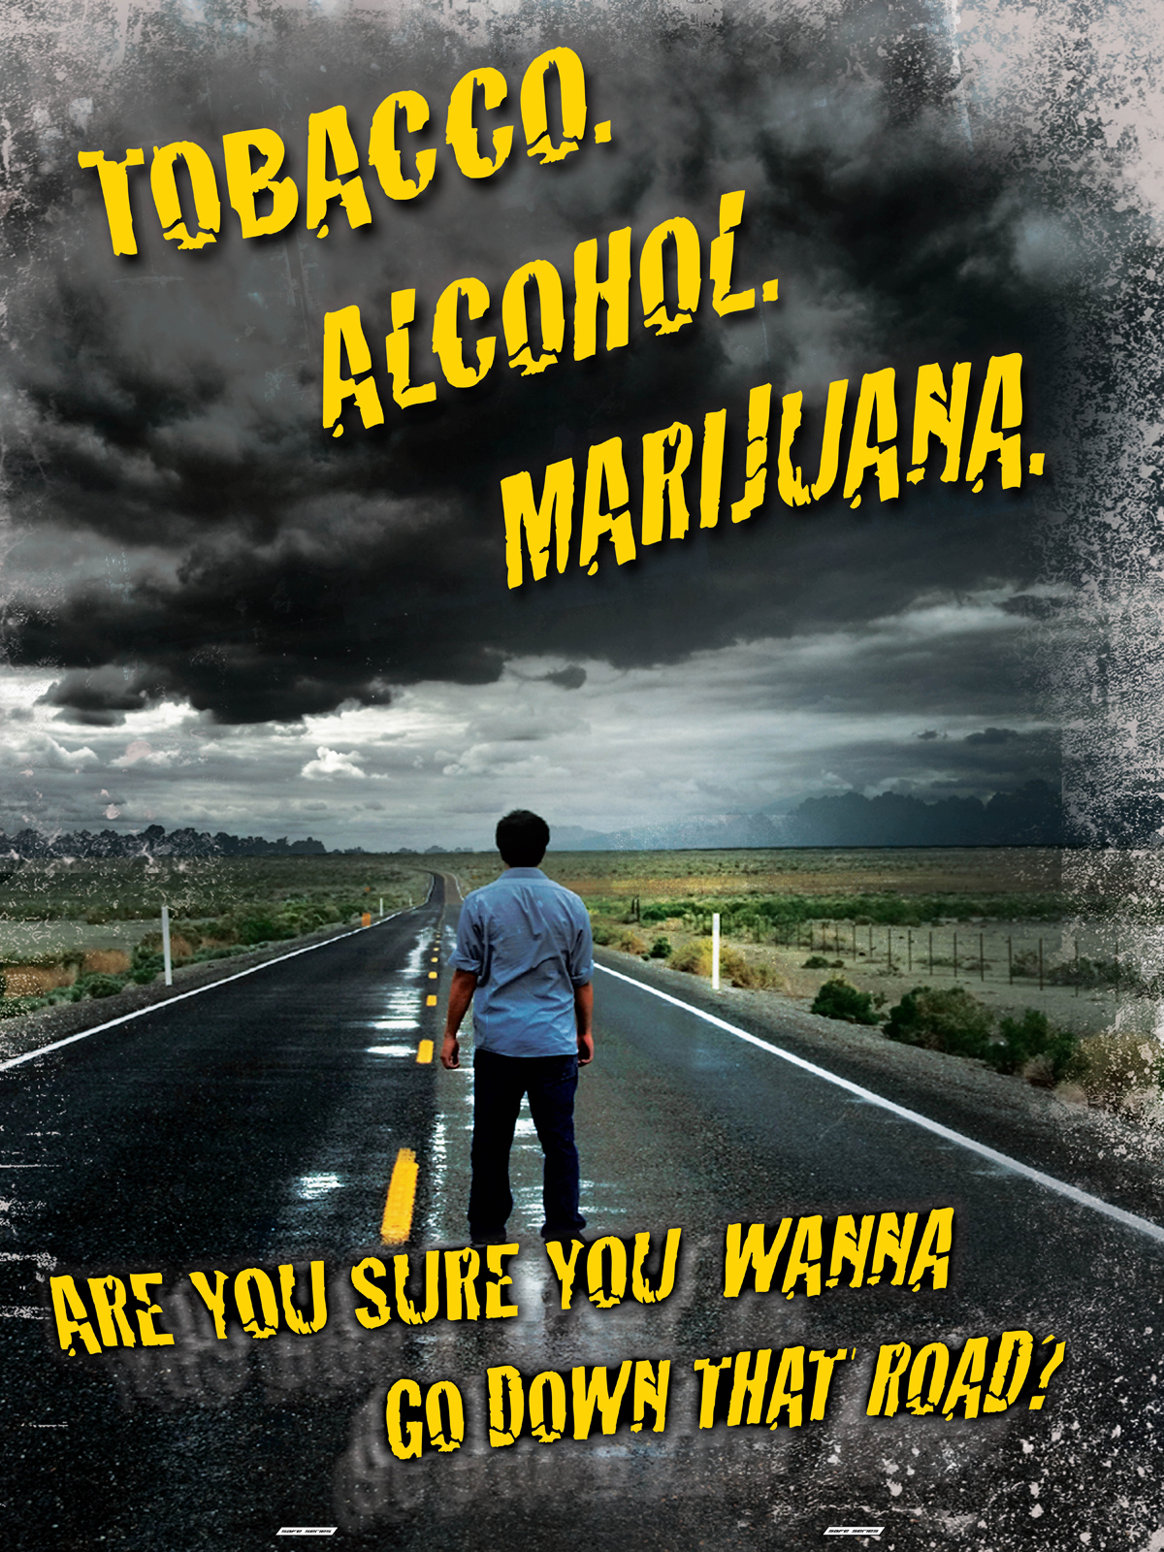
Gateway Drug
Is Marijuana a Gateway Drug: Yes, it is typically used before progression to other drug use
Early Use can lead to increased vulnerability to addiction:
Increased nerve firing and dopamine release in response to acute THC, and dopaminergic blunting associated with long-term use.
Most Users of Marijuana will not go on to use other drugs
It is not the only gateway drug: alcohol and nicotine

Slide 37
Cannabis Use increases risk for Opioid Use
Gateway Drug
Cannabis Use and Risk of Prescription Opioid Use Disorder in the United States
A longitudinal study with a 3 year follow up showed cannabis use increase rather than decreases the risk of developing nonmedical prescription opioid use and opioid use disorder.
Mark Olfson, M.D., M.P.H., Melanie M. Wall, Ph.D., Shang-Min Liu, M.S., Carlos Blanco, M.D., Ph.D.American Journal of Psychiatry, 2018
Teens/Young Adults I have seen with Opioid Use Disorder started with either Marijuana or Alcohol

Slide 38
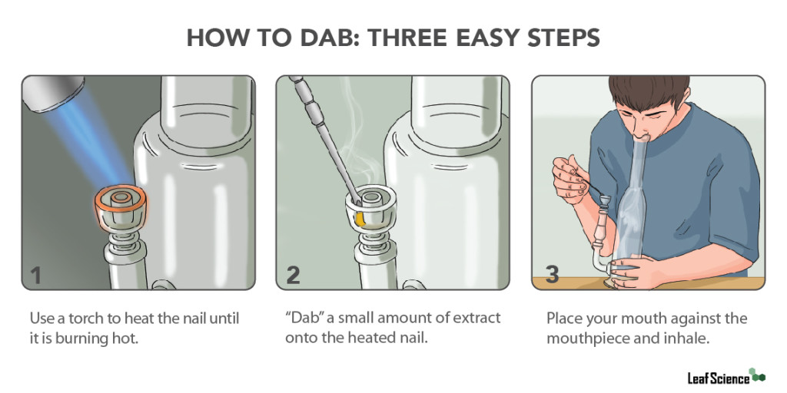
Dabbing

Slide 39
Dabbing
95% THC in some extracts
Burn the extract into vapor and then inhale
Odorless
Gaining popularity
Single dose, quick onset; once can lead to psychosis

Slide 40
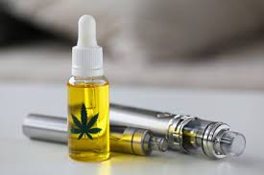
Marijuana Vaping
Vaping THC does not produce the telltale smell that emerges when smoking marijuana through a joint, blunt or pipe. Teens and young adults can use marijuana without being detected
When people vape rather smoke marijuana, they tend to consume even higher concentrations of THC, which means greater exposure to the drug's mind altering and addictive ingredient

Slide 41
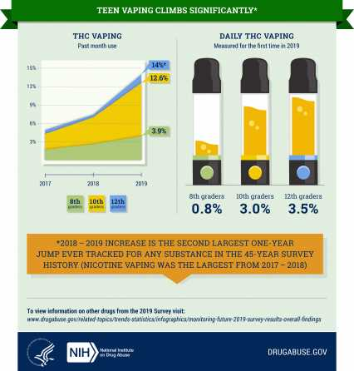
2019 Data
Marijuana Vaping:
Daily Past 30 Day
8th grade: 0.8% 3.9%
10th grade: 3.0% 12.6%
12th grade: 3.5% 14%

Slide 42
Edibles
Products marketed to teens
Cookies, Brownies, Candy
Very potent
Delayed onset of action--Because the “high” is not immediate, teens will consume larger amounts
Ingestion Can Lead to Acute Psychosis

Slide 43
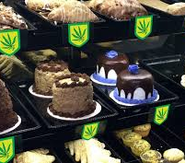
The World of Edibles

Slide 44
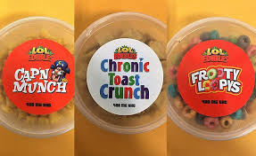
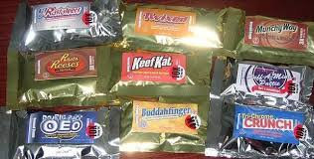
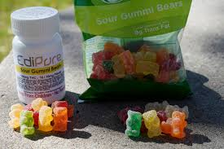
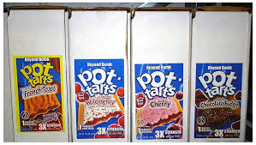
The World of Edibles

Slide 45
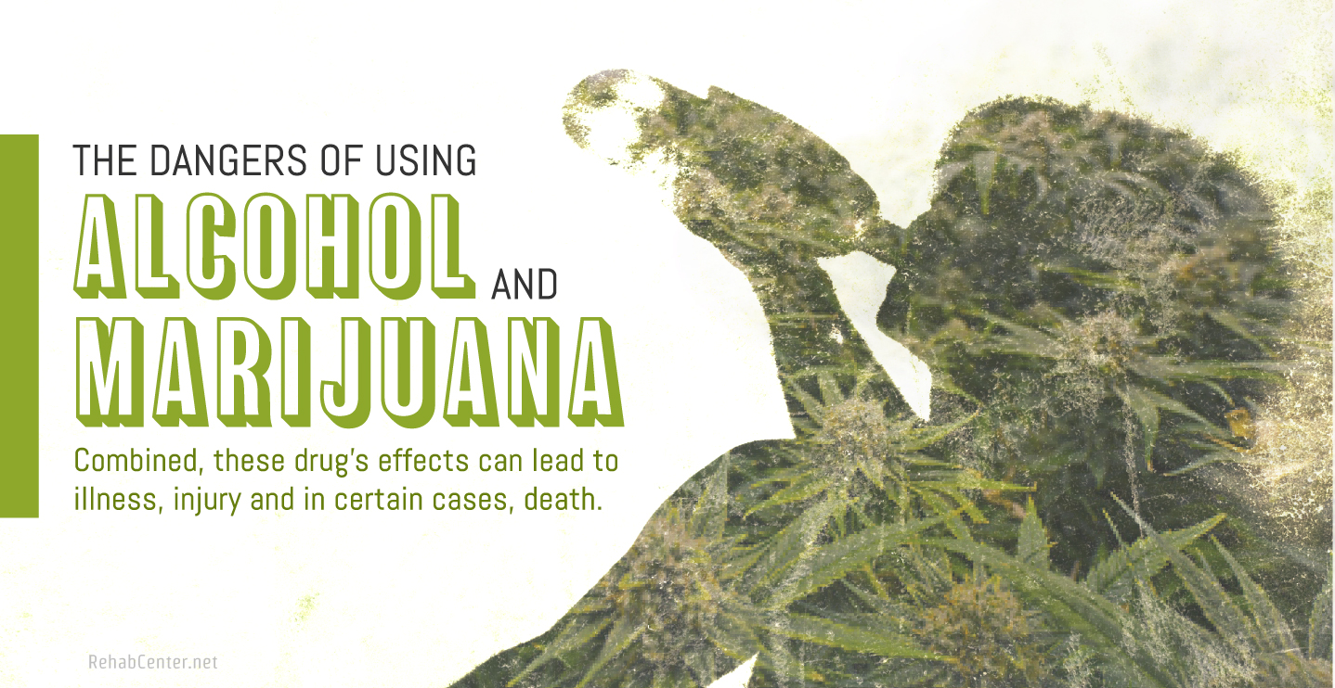
Alcohol and Marijuana are Commonly Mixed
Consumption of any amount of alcohol with marijuana significantly increases THC levels in the user’s blood.
Anxiety, Nausea and Vomiting, Memory Impairment, Fatigue, Hallucinations, Decreased Coordination

Slide 46
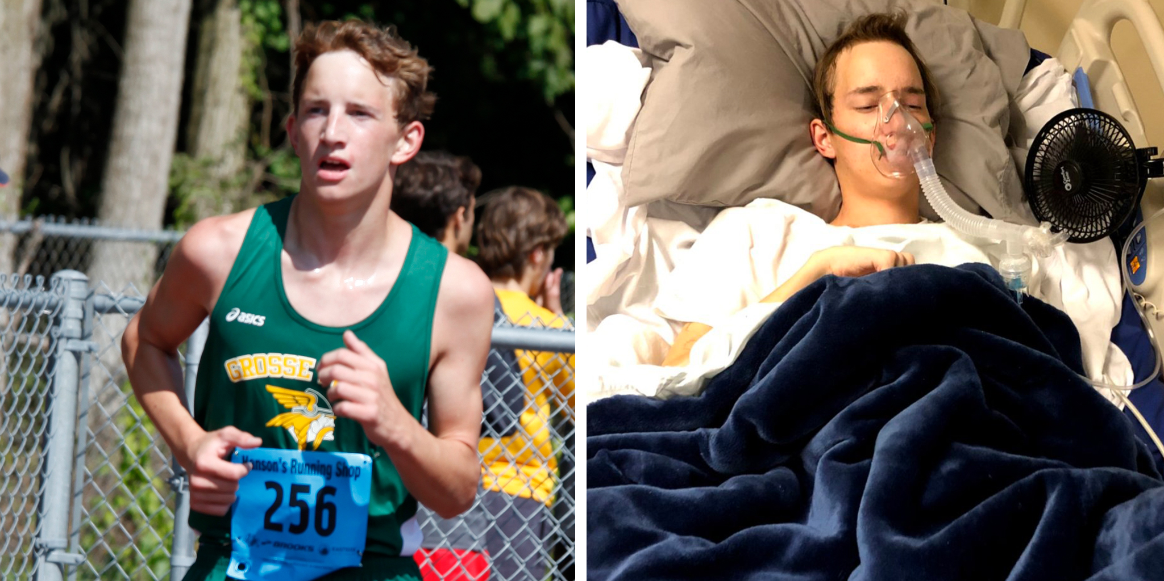
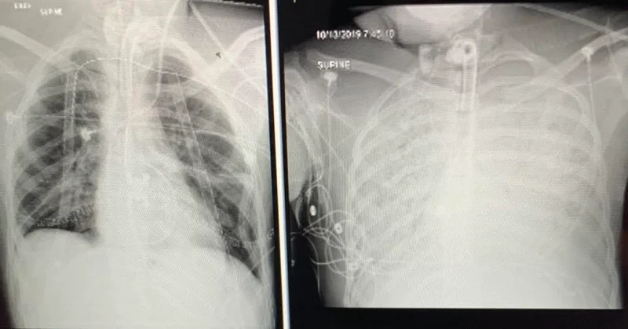
High School Athlete
Started with Casual JUULing
Developed Addiction
Both Nicotine and THC
Double Lung Transplant
https://time.com/5771181/double-lung-transplant-vaping/
January, 2020
2,807 hospitalizations, 68 deaths)
CDC, February 2020

Slide 47
Covid 19 ….
THE PERFECT STORM:
More time on social media
Rise in depression and anxiety
Continued Availability of THC Products

Slide 48
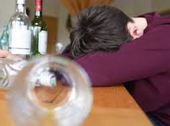
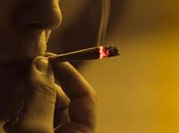
2020 Data
Journal of Adolescent Health, July 2020:
Survey of over 1,000 adolescents in Ontario, pre-Covid and 3 weeks into lockdown:
Numbers of new users did not increase, but use increased overall (alcohol and marijuana)
More reported using alone
Online parties with alcohol and cannabis use

Slide 49
